Slide 1

Customer Shopping Trends Dataset
Journey into Consumer Insights and Retail Evolution
Date -12th December 2023
Student Name –Mihika Mishra
Class Name—Practical Data Science
Program Name- Master’s in Data Science
School Name- Seidenberg School-Pace University
Email-mm31653n@pace.edu

Slide 2
Agenda
Executive summary
Project plan recap
Data
Exploratory data analysis
Modelling Methods
Findings
Recommendations and next step
Appendix

Slide 3
Executive Summary
The Customer Shopping Preferences is a treasure trove of data providing deep insights into customer behavior. It details customer demographics, purchasing patterns, preferred payment methods, and more, which are instrumental for SAM Retail to customize its approach to meet diverse customer needs.
Strategic Alignment: By analyzing the dataset, company will be able to align its product offerings, marketing strategies, and customer service policies with the observed customer trends and preferences. This strategic alignment is expected to bolster customer satisfaction and loyalty.
Data-Driven Decisions: The dataset will empower SAM Retail with the capability to make informed decisions. Leveraging machine learning models, the company can categorize customers into distinct groups, enabling more focused and effective marketing efforts.
Understanding the shopping behaviors and preferences will allow business to stock inventory more effectively and create personalized promotions, which are predicted to significantly enhance the shopping experience and meet the precise needs of each customer segment.

Slide 4
Project plan recap
Deliverable | Details | Due Date | Status
Data & EDA | Create final assignment deck skeleton and fill in the deck up to the end of the EDA section | 10/31/23 | Complete
Methods, Findings, and Recommendations | Fill in the Methods, Findings, and Recommendations sections of the deck | 11/14/23 | Complete
Final presentation | Send in final completed deck and present it | 12/12/23 | Complete

Slide 5
DATA

Slide 6
Data
Data source – Kaggle
This dataset encompasses various features related to customer shopping preferences, gathering essential information for businesses seeking to enhance their understanding of their customer base. The features include customer age, gender, purchase amount, preferred payment methods, frequency of purchases, and feedback ratings. Additionally, data on the type of items purchased, shopping frequency, preferred shopping seasons, and interactions with promotional offers is included. With a collection of 39000 records, this dataset serves as a foundation for businesses looking to apply data-driven insights for better decision-making and customer-centric strategies.
Time Period 2020-2022(2 years).
Assumptions
we assume that the data is accurate and precise

Slide 7
Exploratory Data Analysis

Slide 8
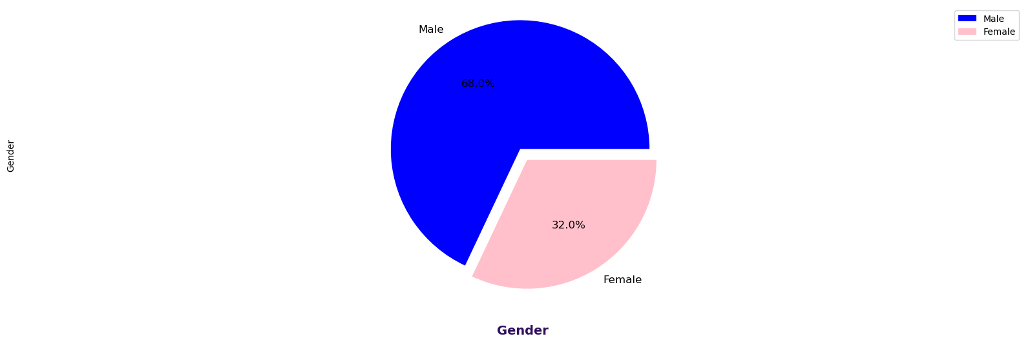
Gender in the data
This shows the count of Gender in the data present which shows us that the large amount of customer is male with 68% where as females are 32 % which brings to conclusion that the majority of shopper in the store are males
Customers span a wide range of ages and both genders, indicating a diverse customer base.
By this data viz we can get to know Purchase amount, frequency, and the category are influenced by customer gender.

Slide 9
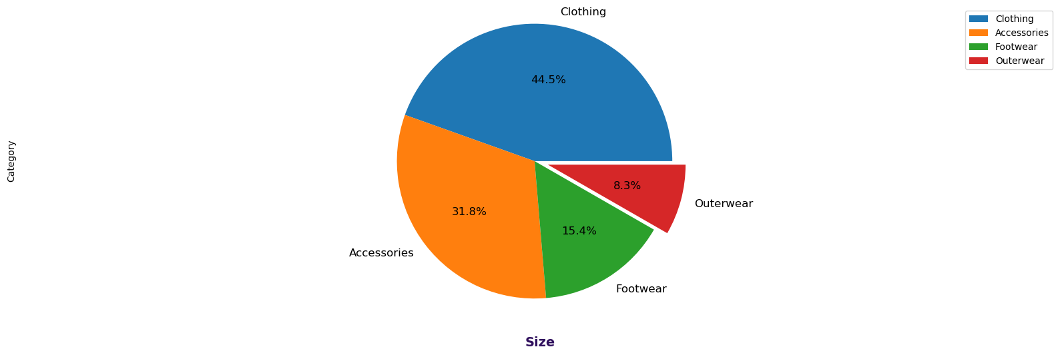
Category of the item purchased
In this chart we can see that the most Category of the item purchased is clothing which concise about 44.5% of the total items
Using this data viz we get to know that the majority of purchase is of clothing followed by accessories ,by this we can also say that the company needs to focus on collecting data for footwear and outerwear and also come up with marketing strategies for increase in purchase.

Slide 10
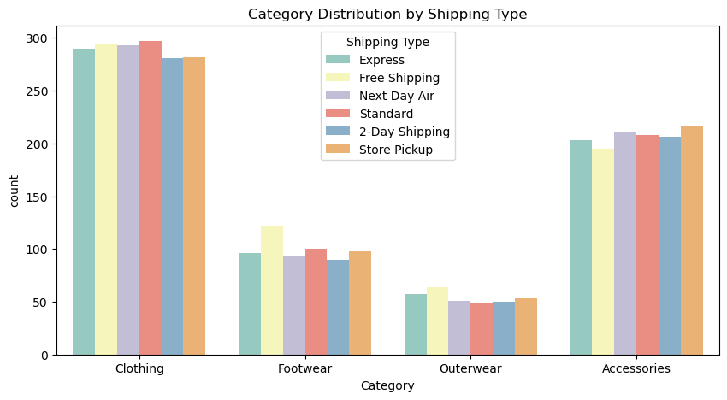
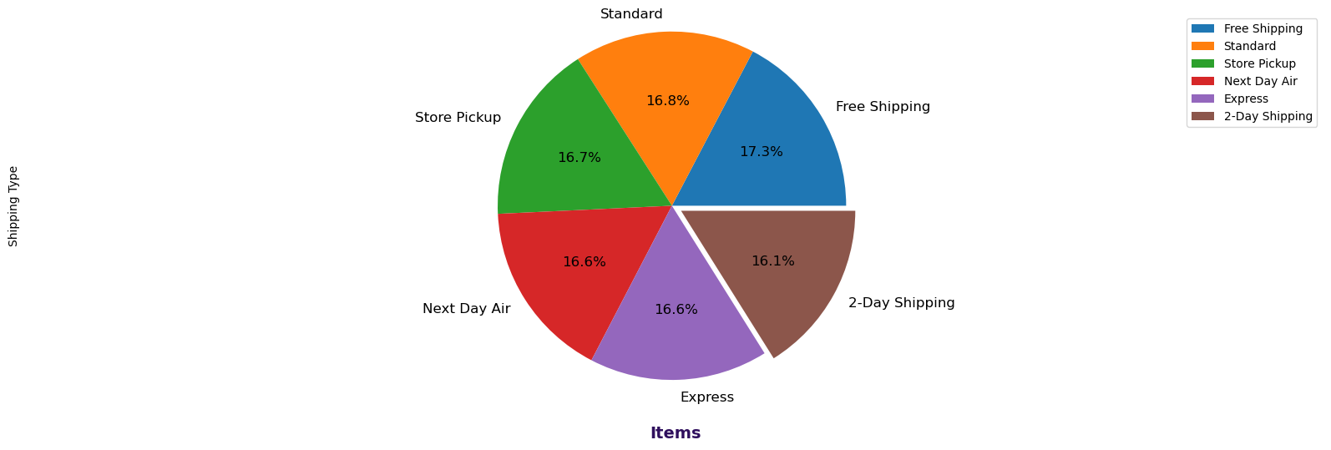
Category distribution by shipping type
Category distribution by shipping type where we can see that the items Mostly shipped are clothing followed Accessories.
Pie chart that illustrates the distribution of different shipping types in a dataset, making it easy to see the proportion of each type relative to the whole.
By this data viz we get to know that the Preferences for shipping types, item size, and color are indicative of specific customer segments, useful for targeted marketing.

Slide 11
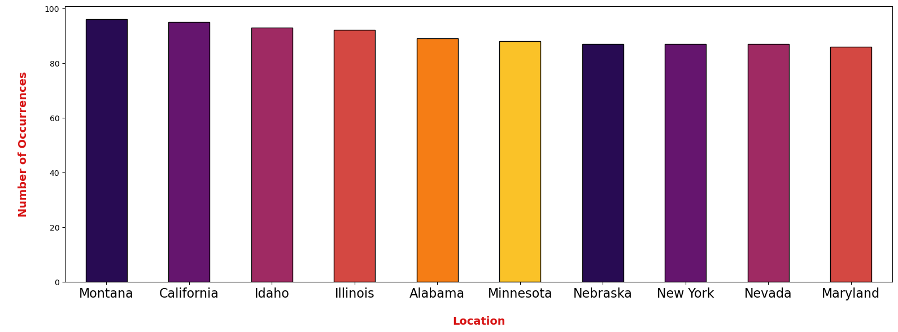
Distribution of occurrences of Locations
Over here we can see that
Montana is the location where high amount of purchase has taken place followed by California and Idaho.
Nebraska ,Newyork ,Nevada and Maryland has the same amount of purchase
By this data viz we get to know the location with highest purchase and one with low purchase. The retail company can increase the profit.

Slide 12
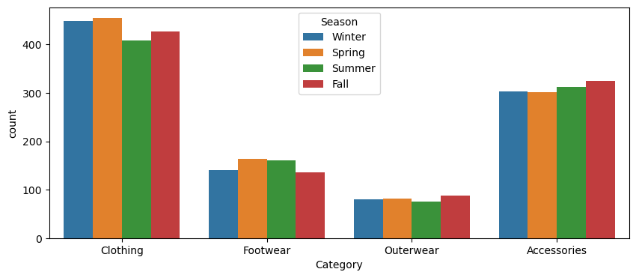
Distribution of Items Category with respect to seasons
Clothing items are mostly purchases in spring season, same goes with footwear, outerwear is purchased in fall season with accessories
By this data viz we get to know Shopping frequency and the type of items purchased are influenced by seasons, suggesting seasonal marketing strategies could be effective.

Slide 13
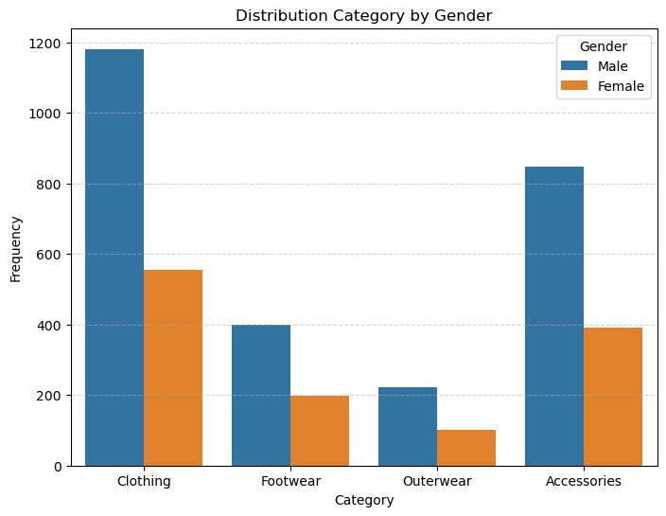
Distribution of category by Gender
Males have larger purchase in all categories.
Most of the purchases are made in clothing category followed by accessories.
The dataset seems to be a male centric shopping store we can conclude this by high number is male customers present.
By this data viz we can get to know Purchase amount, frequency, and the category are influenced by customer gender.

Slide 14
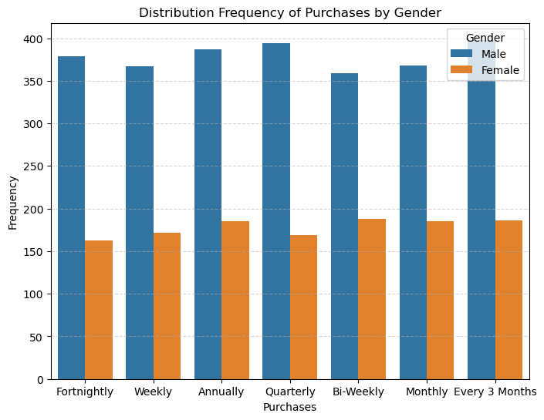
Distribution frequency of Purchases by Gender
While Males tend to do high quarterly purchase, females are more likely purchasing annually from the store
By this data viz we can get to know Frequency purchase history can predict future buying behavior, aiding in the development of long-term customer relationship strategies.

Slide 15
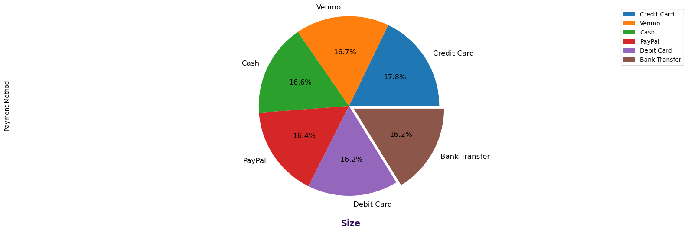
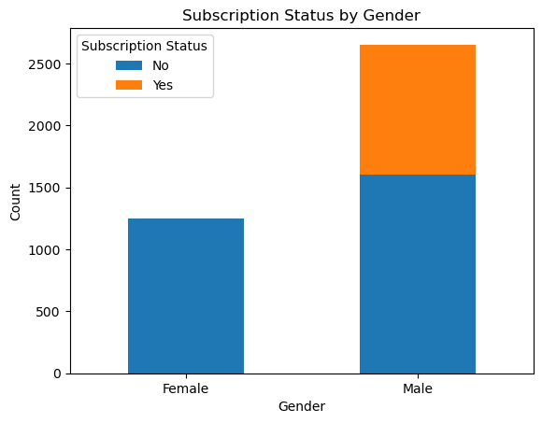
Subscription status by Gender
Transaction Method
Males subscribe to the store subscription whereas females don’t this tells us the behavior pattern of customer in subscription gender wise
By this data viz we can get to know Customers with subscriptions make more frequent purchases, indicating a correlation between subscription status and customer loyalty.
Mostly Purchases are made by credit card with 17.8%, the behavior pattern of customer in transaction method wise
By this data viz we can get to know Preferred payment methods vary significantly, reflecting diverse financial habits and trust levels in payment security.

Slide 16
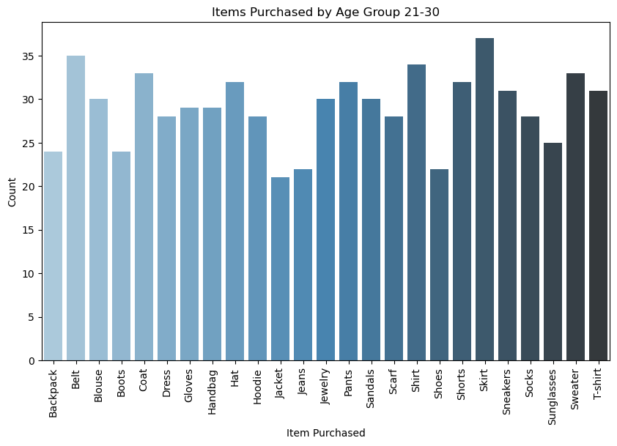
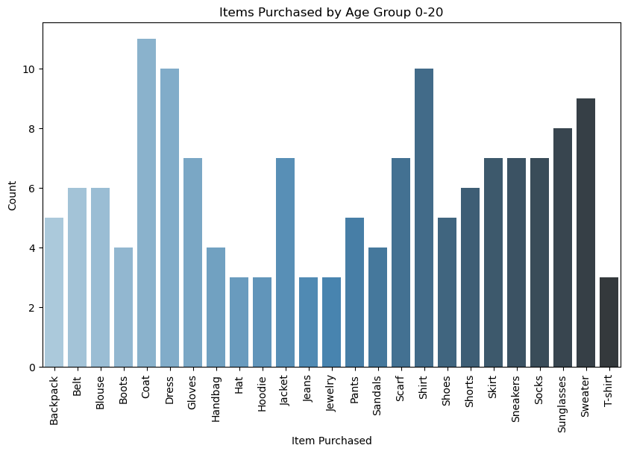
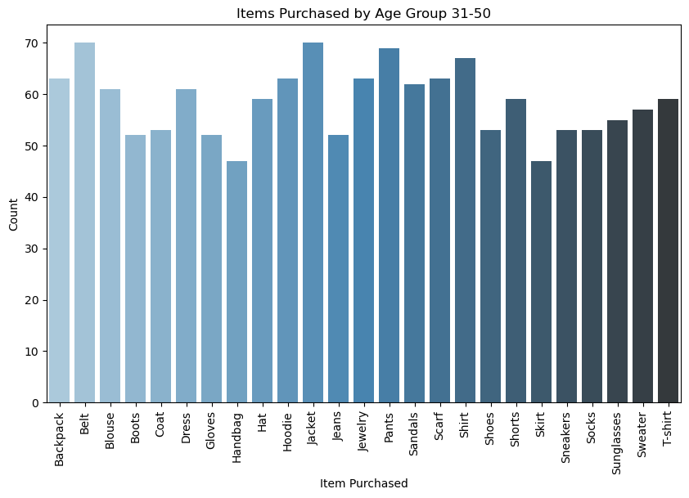
Items Purchased by Age Groups
In the AGE group between 0-20 we can see that higher amount of purchase is made of coat , dress , scarf
In the AGE group between 31-50 we can see that higher amount of purchase is made of Jacket ,belt , Jewelry and shirt
In the AGE group between 21-30 we can see that higher amount of purchase is made of skirt , Belt , sweater and shirt.

Slide 17
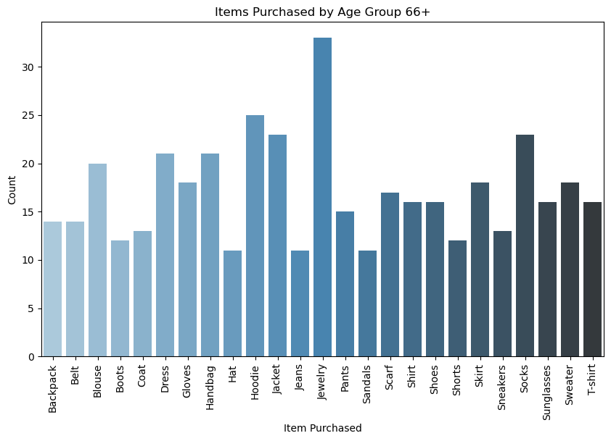
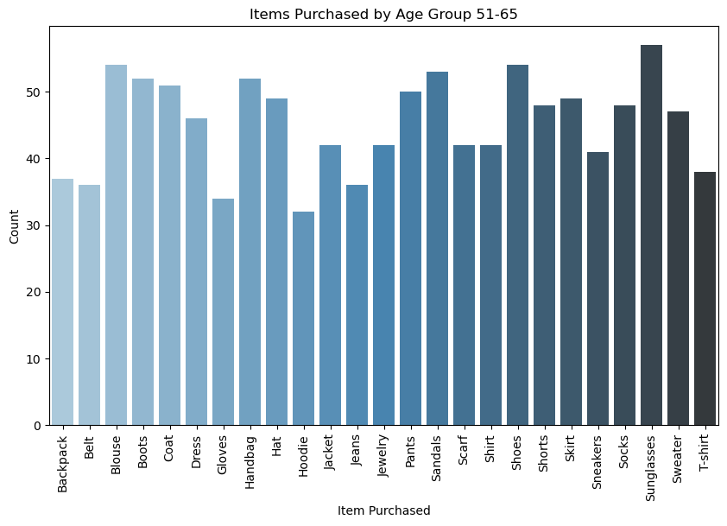
Items Purchased by Age Groups
In the AGE group between 51-65 we can see that higher amount of purchase is made of sunglasses , shoes ,handbag and blouse
In the AGE group between 66+ we can see that higher amount of purchase is made of Jewelry with hoodie and socks
By this data viz we get to know that customers span a wide range of ages, indicating a diverse customer base.
Purchase amount, frequency, and the category are influenced by customer age.

Slide 18
Modeling Methods

Slide 19
K-means Clustering
Imagine you own a store and want to understand your customers better so you can serve them better ads, offer them deals they'll like, or simply stock more of the items they love. To do this, we have a smart system that groups customers based on what they buy, how much they spend, how often they shop, and what they say about us.
Here's how it works:
Sorting Customers: Categorize customers into different 'baskets' based on spending habits, visit frequency, etc.
Example: High spenders, Frequent visitors
Finding Patterns: Analyze shopping habits to identify common behaviors.
Creating Groups: Form clusters of customers with similar shopping patterns.
Adjusting to Customers: Tailor store offerings based on group preferences.
Key Benefit: Personalized shopping experience by learning from customer choices, without intrusive questioning.
Link-Findings

Slide 20
Why k-means clustering
The Features We Look At: The model doesn't just look at what people buy. It considers several features – like:
'Purchase Amount (USD)': How much money they typically spend on each visit.
'Previous Purchases': How often they've shopped with us before.
Age: It might give us a clue about their stage in life, which can influence shopping habits.
Gender: To tailor promotions for products traditionally favored by different genders.
Item Purchased and Category: To understand what products are popular among different groups.
Review Rating: How happy they are with their purchases, which tells us if we're on the right track with our product offerings.
Why It's Useful: With this information, we can create a more welcoming and personalized community space. For instance, if we know a group often buys children's toys, we might send them updates when we have a toy sale or a new collection. If another group often buys books, we could invite them to a book club or author signing event.
For Technical slide go to this link- Appendix section

Slide 21
K-Prototypes model
Imagine you're a chef in a large restaurant. You want to create a special menu that appeals to different groups of diners. You know various things about your diners, such as their favorite ingredients (categorical feature), how much they usually spend (numerical feature), and how spicy they like their food (categorical feature).
K-Prototypes clustering is like creating the perfect seating chart for a dinner party. It's a method where you sort diners into groups based on what you know about them:
Favorite Ingredients (Categorical): You group people who like similar ingredients. For instance, some love avocado and quinoa, while others prefer steak and potatoes. These preferences are like categorical features because they are distinct and specific categories.
Spending (Numerical): You also consider how much diners are willing to spend. Those who enjoy fine dining and expensive wines might be grouped together, whereas budget-conscious diners who prefer a simple meal would form another group. These are numerical features because they can be measured and compared directly.
Spice Preference (Categorical): Some like it hot, and others don't. Grouping diners by those who enjoy a fiery meal versus those who prefer milder flavors helps you tailor the spice levels to each table.

Slide 22
Why K-prototype
By using K-Prototypes, you're essentially finding patterns in these preferences and habits. Once you have your diners sorted into these groups, or clusters, you can craft a special menu for each table that caters to their tastes. This way, the steak-lovers have a selection of hearty dishes to choose from, while the vegetarians have a variety of veggie delights.
The Benefit: This isn't just about creating meals; it's about enhancing the dining experience. When diners get a menu that seems personalized, they enjoy their meals more and are likely to come back. For the restaurant, this means happier customers and better business.
In the same way, businesses use K-Prototypes clustering to understand their customers better. By knowing who prefers what, they can create targeted marketing campaigns, develop products that meet specific needs, and offer services that make their customers feel valued and understood. It's about creating a personalized experience that resonates with each unique group of customers.
For Technical slide go to this link- K-Prototype

Slide 23
Findings

Slide 24
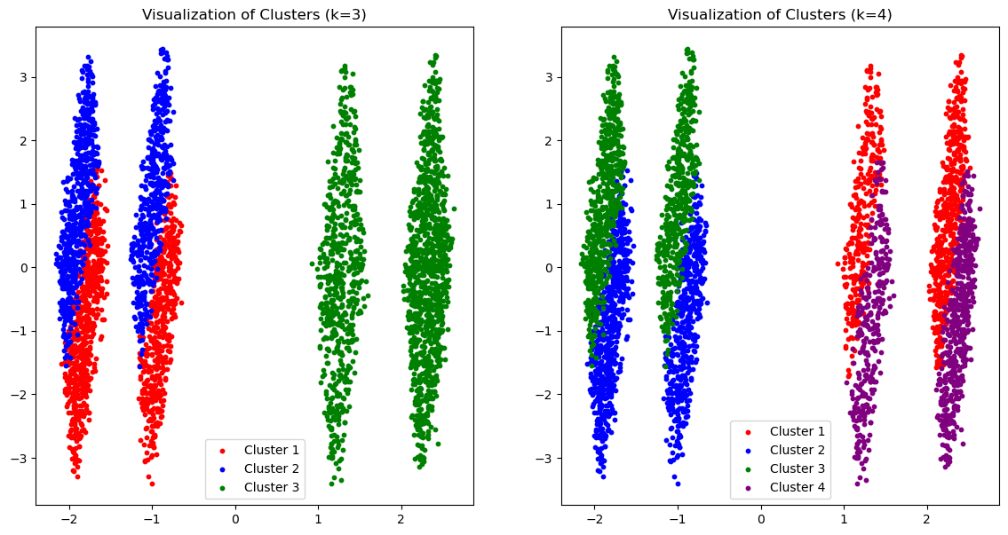
Finding of K-means Clustering Model
In k-means Clustering model we have used Elbow Method to find the optimal number of clustering for the model that means the number of group to be formed. The elbow plot is a simple way to choose a good number of groups or clusters by finding the point in a graph where increasing the number of clusters doesn't give much better grouping of the data .In this model the optimal number is 4
The visualization helps to understand how well the clustering algorithm is performing and whether the chosen number of clusters (k) is capturing the natural divisions within the data.
It can also guide further analysis, such as investigating the characteristics that define each cluster, which can then inform business strategies, customer engagement, product development, etc.
For detailed explanation-Elboe method detailed explanation

Slide 25
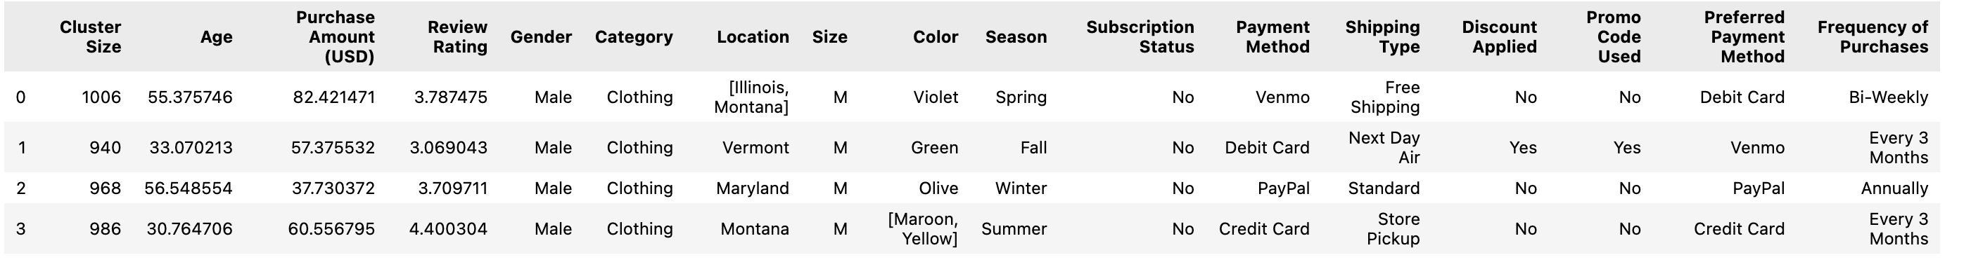
Finding of K-Prototypes
Cluster Size: The number of customers in each cluster. The clusters vary in size, with the largest having 1006 customers and the smallest 940.
Age: The average age of customers within each cluster. This ranges from younger customers (average age around 30) to older ones (average age over 55).
Purchase Amount (USD): The average amount spent by customers in each cluster. This indicates that some clusters spend more on average than others.
Review Rating: The average review rating provided by customers in each cluster. Higher ratings suggest more satisfaction with the purchases.
Gender: The gender that predominates in each cluster is male.
Category: The type of product most often purchased in each cluster, which in this case is clothing for all.

Slide 26
Finding of K-Prototypes
Location: The common geographic locations of customers within each cluster. It could represent the states where most customers from each cluster are from.
Size: The most common size for clothing purchased in each cluster is medium (M).
Color: The preferred clothing color in each cluster, with some clusters having a single preferred color and others having multiple.
Season: The season when most purchases are made within each cluster.
Subscription Status: Whether customers in each cluster are subscribed to a service, which is 'No' for all clusters.
Payment Method: The most common payment method used by customers in each cluster.
Shipping Type: The preferred shipping method for each cluster, which varies from free shipping to store pickup.
Discount Applied: Whether customers in each cluster commonly use discounts, which varies between clusters.
Promo Code Used: Whether customers in each cluster commonly use promo codes.
Preferred Payment Method: The payment method preferred by customers in each cluster, which could indicate their comfort with certain financial instruments.
Frequency of Purchases: How often customers in each cluster make purchases, ranging from bi-weekly to annually.
This table is valuable for a business because it identifies distinct groups of customers based on their shopping
behaviors and preferences. With this information, the company can tailor its marketing strategies,
stock inventory according to preferences, create personalized promotions, and enhance customer experiences
to better meet the needs of each customer segment.

Slide 27
Recommendations & Next steps

Slide 28
What we can do ! Next step
Personalized Offers: Just like you might offer a banana-flavored treat to someone who loves bananas, send out special deals or product recommendations to customers based on the group they're in.
Tailored Services: If you know that a group of customers always chooses next-day delivery, you might want to make sure that option is always available and easy to select for them.
Feedback Loop: Ask for feedback specifically from each group. It’s like asking each fruit basket what they thought of the fruit. This helps you understand if they're getting what they want.
Custom Experience: Adjust your website or store to cater to each group. If one group tends to buy more when they visit in the evening, maybe extend your hours or offer evening specials.
Loyalty Programs: Create a loyalty program that rewards the behaviors you see in each group. If one group buys frequently but spends less, give them points for each purchase that add up to discounts over time.
The goal is to make every customer feel like you know them and are giving them a shopping experience that’s tailored just for them. It’s about making sure they leave happier and come back more often, just like guests at a party who had a great time and can’t wait for the next one!

Slide 29
Next step!
We can collect more data to take a look at customer behavior pattern
Validation: Validate the clusters by comparing the clustering model’s predictions with actual customer behavior. Are the customers in each cluster behaving as the model suggests?
Monitoring: Continuously monitor customer data to ensure clusters remain relevant over time. Update clustering as customer behavior and the market evolve.
Testing: Test the effectiveness of targeted strategies derived from clustering through A/B testing or control groups to measure impact.
Feedback Incorporation: Collect customer feedback to further refine the customer profiles and adjust cluster definitions if necessary.
We can also try and use Hierarchical Clustering(Useful for smaller datasets where the relationships between clusters are of interest. It can provide a different perspective on cluster formation.)DBSCAN (Good for datasets with noise and outliers, and where clusters may not be spherical in shape. It doesn't require specifying the number of clusters beforehand)

Slide 30
Appendix section

Slide 31
Technical Explanation of Models
K-Prototypes
K-Prototypes is a clustering algorithm that is an extension of K-Means and is specifically designed to handle datasets with mixed data types — both categorical and numerical. Here's how it works:
Algorithm Selection: K-Prototypes combines the cost functions of K-Means and K-Modes, allowing it to find clusters based on the similarity of numerical features (like age, income, etc.) and the frequency of categorical features (like gender, product category, etc.).
Data Preparation: Before running the algorithm, numerical data is usually standardized to ensure that all features contribute equally to the distance calculations. Categorical data is encoded appropriately since K-Prototypes uses a different method to calculate the similarity between categorical features.
Cluster Initialization: The algorithm starts by initializing K 'prototypes' (centroids) for each cluster, which are representative of the points within the cluster. Each prototype has a centroid for numerical attributes and a mode for categorical attributes.

Slide 32
K-Prototypes
Iteration: The algorithm then iterates through the dataset, assigning each data point to the nearest prototype based on a distance metric that combines the numerical and categorical differences. After all points are assigned, the prototypes are updated to better represent the points in their clusters.
Convergence: This process repeats until the assignments no longer change or the changes are below a certain threshold, which means the clusters are relatively stable and the algorithm has 'converged'.
Use of Model: The resulting model can segment the dataset into distinct groups. For businesses, this segmentation can be used for targeted marketing, personalized recommendations, efficient resource allocation, and better understanding of customer behavior patterns.
Link- K-Prototypes model

Slide 33
K-means clustering
The model we are discussing is a k-means clustering model. K-means is an unsupervised machine learning algorithm that is used to group similar data points into a specified number (k) of groups, known as clusters, based on feature similarity. Here's a more technical breakdown:
Algorithm: K-means clustering partitions the dataset into k clusters by assigning each data point to the cluster with the nearest mean, serving as a prototype of the cluster.
Feature Selection: For clustering, we selected numerical features such as 'Purchase Amount (USD)' and 'Previous Purchases', and converted categorical features like 'Age', 'Gender', 'Item Purchased', etc., into numerical formats using label encoding.
Scaling: We scaled the features to treat all dimensions equally in terms of scale.
Dimensionality Reduction: PCA was likely used to reduce the dimensionality of the feature space to visualize the clustering in two dimensions.
Cluster Centers: We interpret clusters by examining the centroids, which are the mean of the features within each cluster, to understand the defining characteristics of each group.
Model Evaluation: We used the elbow method to determine the optimal number of clusters, which involved plotting the within-cluster sum of squares (WCSS) against the number of clusters and looking for a point where the decrease in WCSS begins to slow down (the elbow point).
The use of this model is primarily for segmenting the customer base into distinct groups that share similar behaviors and characteristics. This segmentation enables targeted marketing, personalized product recommendations, and strategic decision-making.

Slide 34
K-means clustering
K-means clustering is chosen for several reasons in data science and machine learning applications:
Simplicity and Speed: K-means is a straightforward algorithm that partitions the data into K clusters. It scales well to large datasets and converges quickly in practice, making it suitable for a range of applications.
Feature Space Analysis: It is particularly effective when the feature space is well-defined and the clusters tend to be spherical and evenly sized. This means that when features can numerically represent the data points, K-means can find natural groupings efficiently.
Interpretability: The results of K-means are easy to interpret, making it an excellent exploratory tool for identifying and describing groups within the data.
Versatility: It can be used as a standalone method to gain insights into data distribution or as a preprocessing step for other algorithms, for example, to initialize centroids for Gaussian Mixture Models or as feature engineering for classification tasks.
Optimization Criterion: It minimizes the within-cluster variance, which is a clear and simple objective that often aligns with the intuitive understanding of what a 'cluster' is.
Link- k-means clustering

Slide 35
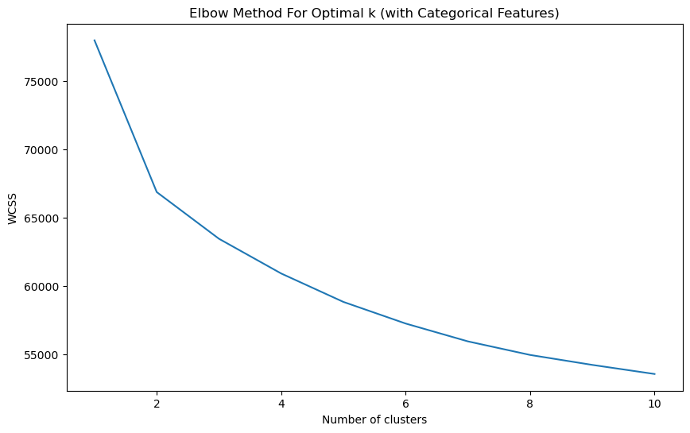
Elbow Method
Imagine you're trying to organize a large group of people into smaller groups where everyone in each group has similar interests. If everyone is in one big group, it's not very organized, but if everyone is in their own group, it's too split up. We want to find a good middle ground.
This chart helps us find that balance. It's like a game where we try to form groups that are as small as possible without splitting everyone up too much. On the chart, each step to the right means we're making more groups. The height of the step shows us how much better our organization is compared to the last step.
At first, when we make a few big groups, it really helps to organize our people. But after a certain point (which looks to be around group number 4 on the chart), making more groups doesn't really help us get more organized. The line starts to flatten out, meaning we've found a good balance.
So, according to this chart, the number of groups that gives us the best organization without overcomplicating things is about four. That's our "sweet spot" for grouping people by their interests.

Slide 36
Elbow Method
This plot is a visualization of the elbow method used in determining the optimal number of clusters for k-means clustering. The x-axis represents the number of clusters (k), and the y-axis represents the within-cluster sum of squares (WCSS), which is a measure of the compactness of the clusters. WCSS decreases as k increases because the clusters are smaller and the data points are closer to the centroids.
The "elbow" of the plot is the point at which the WCSS begins to decrease at a slower rate, indicating that adding more clusters does not significantly improve the fit of the model. This point represents a balance between the number of clusters and the sum of the distances between the points and their respective cluster centroids.
From the plot, the elbow seems to occur around k=4, suggesting that increasing the number of clusters beyond 4 yields diminishing returns in terms of compactness of the clustering. Therefore, the optimal number of clusters for this particular dataset might be 4, as additional clusters do not contribute to a significant decrease in WCSS.

Slide 37
K-means clustering
For the plot with k=3:
The data points are color-coded as red, blue, and green, representing the three different clusters.
The clusters appear well-separated, which suggests that the model has done a good job at grouping similar data points together.
Each cluster is a vertical distribution of points, which may suggest that the principal component (often the x-axis in such plots) has a significant variance and is a strong factor in differentiating the data points.
For the plot with k=4:
An additional purple cluster appears when the number of clusters is increased to four.
The separation between the red and purple clusters is not as distinct as between the other clusters. This might suggest that the distinction between these two groups is less clear, or they have more subtle differences.

Slide 38
K-means clustering
The clusters are still mostly vertical, like in the k=3 plot, which again indicates that the principal component has a major role in the clustering.
The visualization helps to understand how well the clustering algorithm is performing and whether the chosen number of clusters (k) is capturing the natural divisions within the data.
Interpreting the Plots:
The tightness of each cluster suggests that the members of each cluster are relatively similar to each other in terms of the underlying features that were used for the clustering.
The distance between clusters indicates that the clusters are quite different from each other on the principal components that the PCA has identified.
The choice between k=3 and k=4 would depend on the context of the data and the goal of the clustering. If the aim is to define broad customer segments, k=3 might be sufficient. However, if more granular segmentation is needed, for instance, to target marketing campaigns more precisely, k=4 might be more appropriate despite the less distinct separation between some of the clusters.

Slide 39
K-means clustering
For each type of shopper, we have some average information:
Age: How old they are on average. It looks like most of our shoppers are around the same age, with little difference between the groups.
Purchase Amount (USD): How much money they tend to spend. Some groups (like groups 5, 6, 7, and 8) spend a lot more on average—these might be our big spenders.
Review Rating: How happy they are with their purchases. The highest scores are from groups 7 and 8, so they seem to be our most satisfied shoppers.
Previous Purchases: How often they've shopped with us before. Some groups come back a lot more often, so they might be our regulars.
The last two columns (Cluster_Labels_3 and Cluster_Labels_4) tell us how these groups change a bit if we decide to think about our shoppers in three big groups instead of four. It’s a way of seeing whether we want to look at our shoppers in broad terms or with a bit more detail.
By understanding these different groups, we can make sure we have the right products and offers for everyone, making their shopping experience as great as it can be.

Slide 40
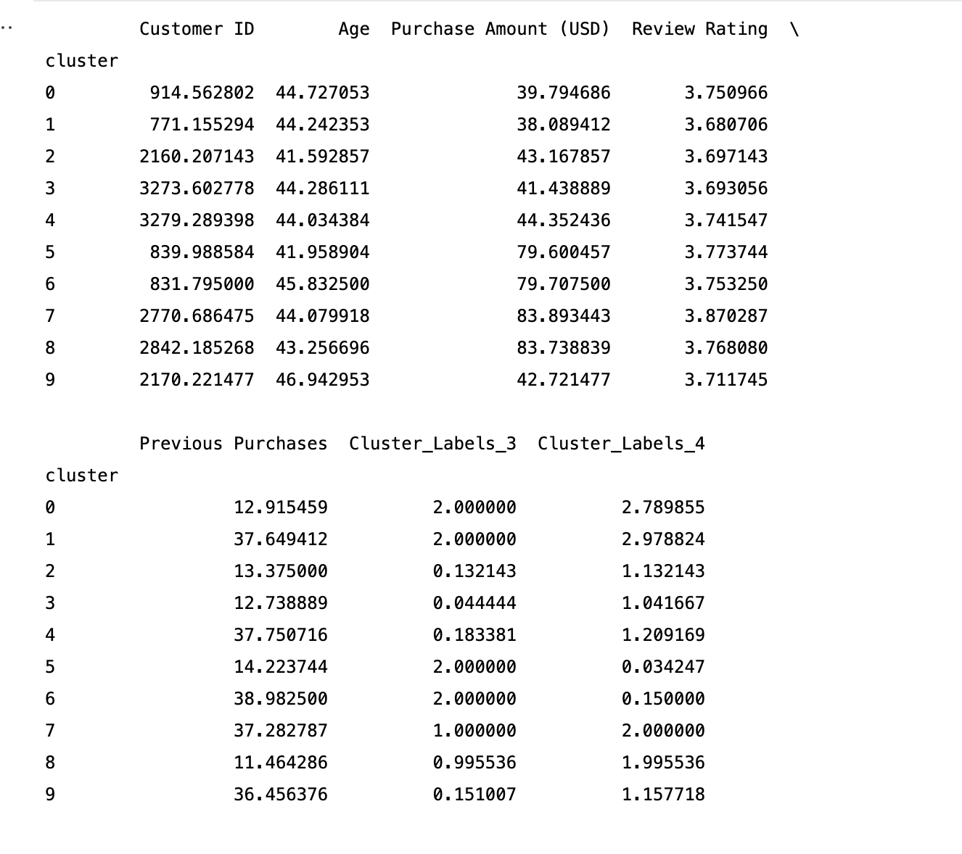
K-means clustering
The table represents the centroids of clusters formed by a k-means clustering algorithm, applied to a dataset with customer shopping behavior. Each row corresponds to a cluster and each column shows the average value of a particular feature for that cluster. The features include customer demographics and purchasing metrics:
Customer ID: Not typically used in analysis, as it's a nominal feature without intrinsic meaning for clustering.
Age: The average age of customers in each cluster, which does not vary significantly across clusters.
Purchase Amount (USD): The average spending per purchase, which varies, indicating different spending behaviors. Clusters 5, 6, 7, and 8 have notably higher values, suggesting they represent higher spending customers.

Slide 41
K-means clustering
Review Rating: The average rating given by customers, with clusters 7 and 8 giving the highest ratings on average.
Previous Purchases: The average number of past purchases, with clusters 1, 4, 6, and 9 having higher frequencies, which may indicate customer loyalty or engagement.
Cluster_Labels_3: The dominant cluster assignment when the data is partitioned into 3 clusters.
Cluster_Labels_4: The dominant cluster assignment when partitioned into 4 clusters.
This information is used for customer segmentation, informing marketing strategies, personalizing the customer experience, and inventory management.

Slide 42
K-prototype findings Explanation
Cluster Formation: The model have grouped customers into clusters based on shared characteristics. For example, one cluster might consist of younger customers with high spending and high review ratings, while another might be older customers with moderate spending and diverse review ratings.
Customer Segments: By examining the means of numerical features and the modes of categorical features within each cluster, you could identify distinct segments of your customer base. For instance, one segment might frequently use promo codes and prefer next-day shipping, indicating a desire for immediate gratification and sensitivity to price.
Purchase Behaviors: The clusters might show different purchasing behaviors, such as a tendency to buy certain product categories more than others, or a preference for shopping during specific seasons.
Marketing Insights: The analysis could reveal which customer segments are more likely to respond to discounts and promotions, thus informing targeted marketing strategies.
Service Preferences: The clusters might also highlight preferences for different types of service, like shipping options. Some groups might prefer free shipping over fast shipping, indicating a potential trade-off between cost and convenience.
Payment Methods: The model findings could show preferred payment methods among different clusters, which could inform the payment options you prioritize or highlight in your checkout process.
Loyalty Indicators: You might find clusters with varying degrees of loyalty, indicated by the frequency of purchases and subscription status. This could inform loyalty programs or retention strategies.

Slide 43
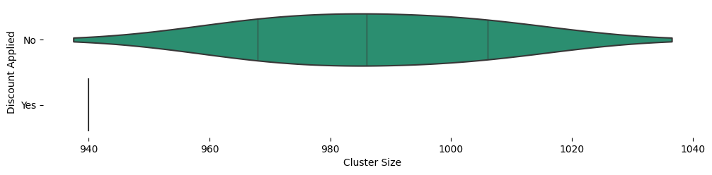
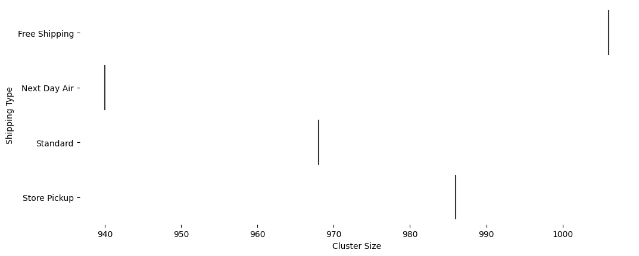
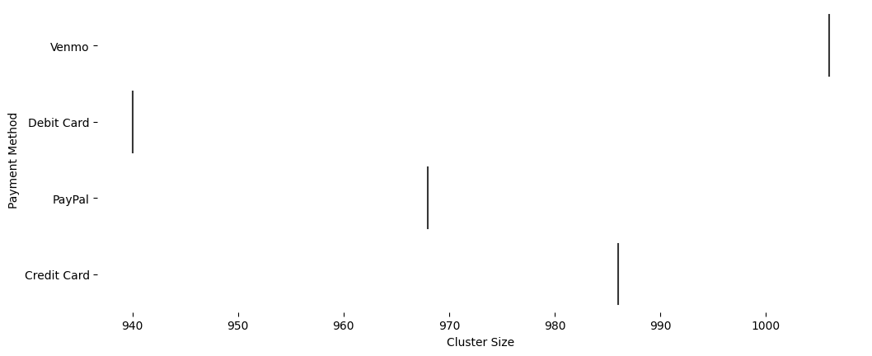
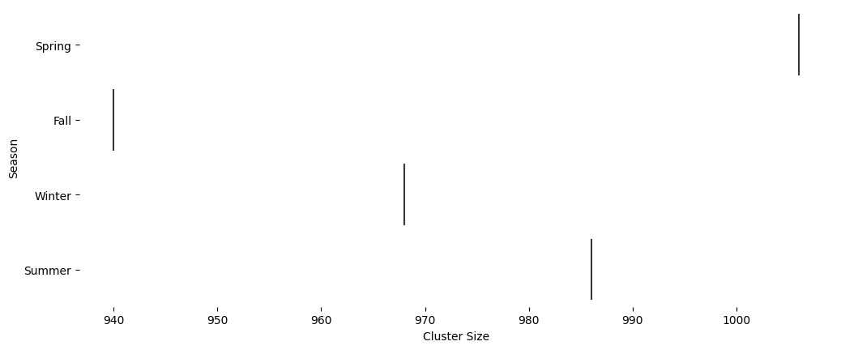
Faceted distributions

Slide 44
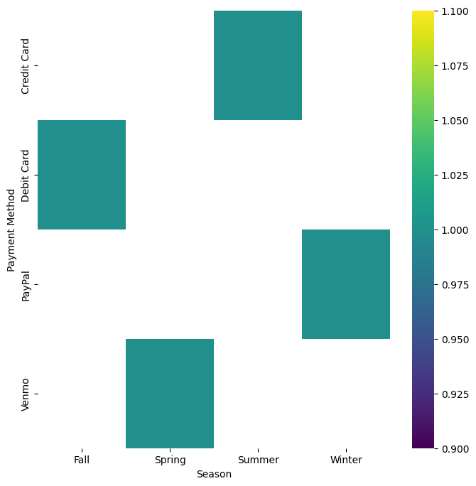
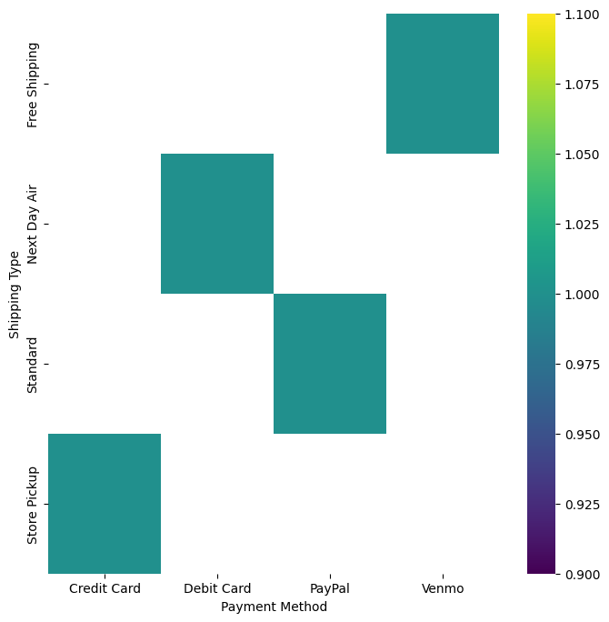
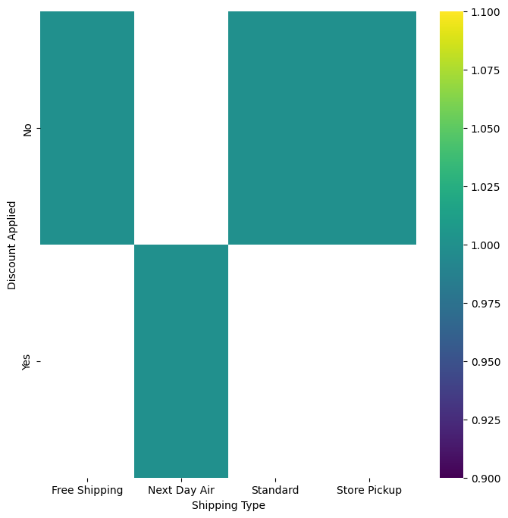
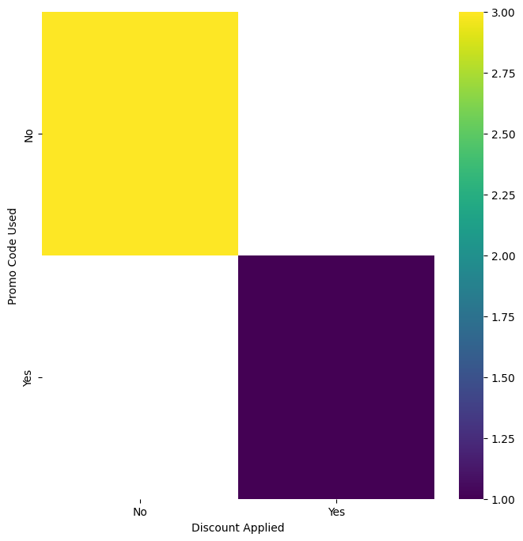
2-d categorical distributions

Slide 45
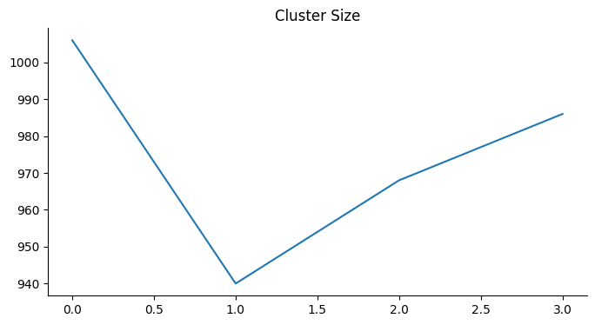
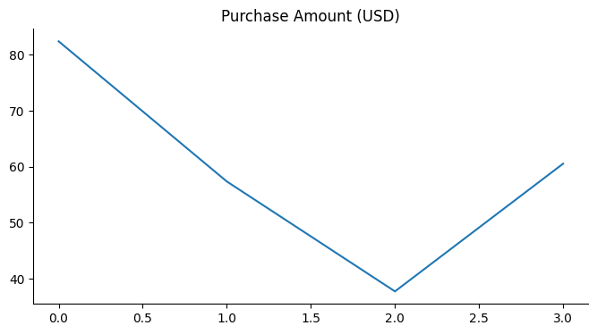
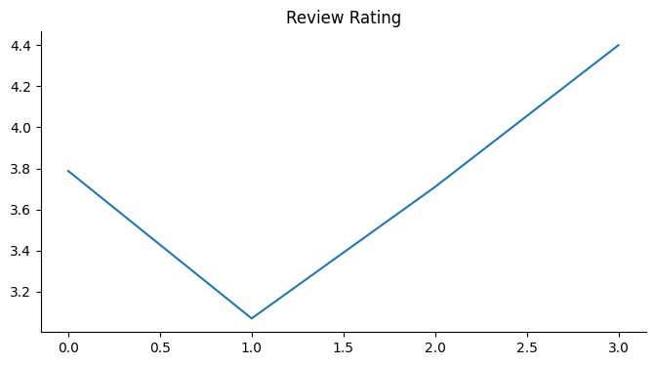
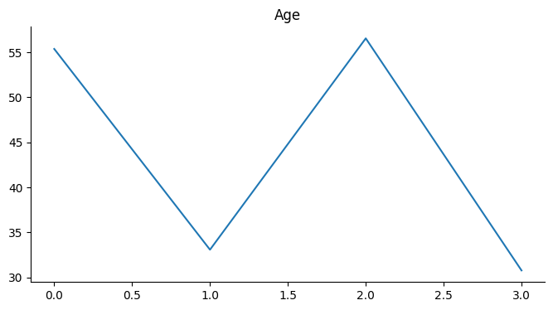
Values

Slide 46
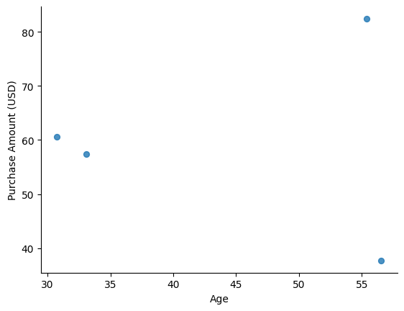
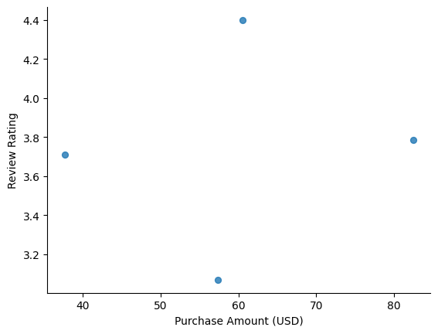
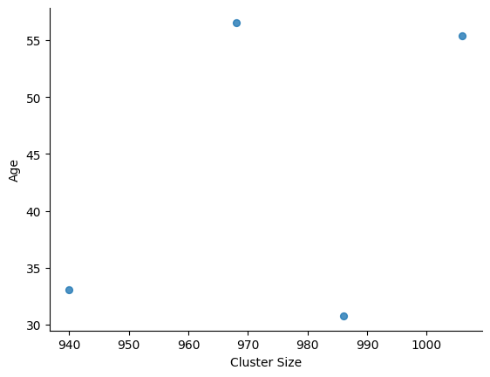
2-d distributions

Slide 47
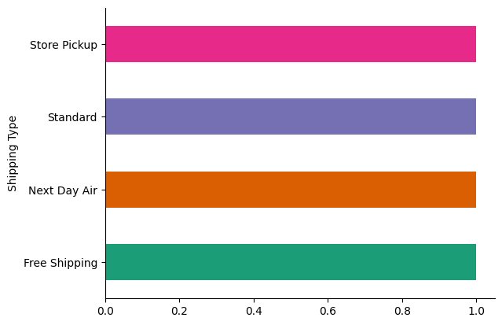
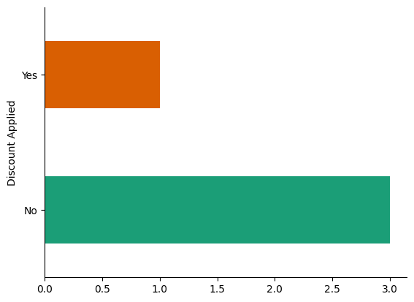
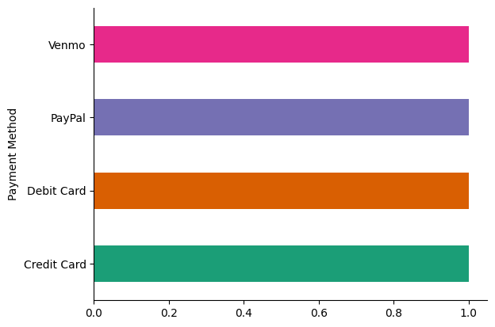
Categorical distributions

Slide 48
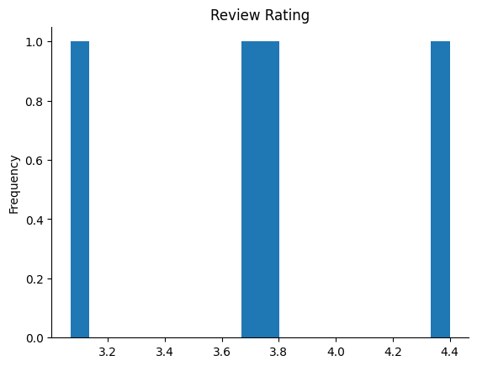
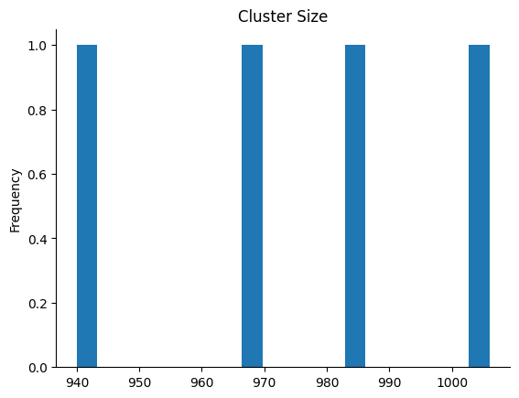
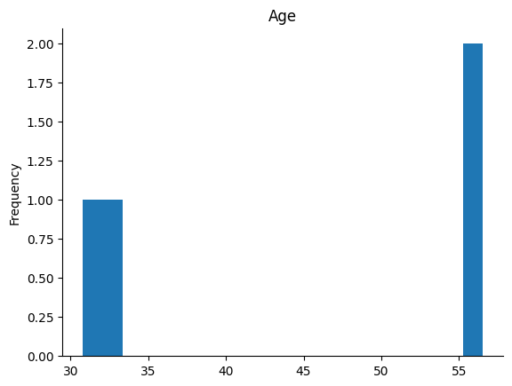
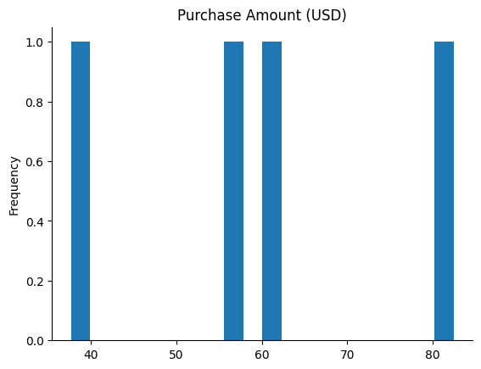
Distributions

Slide 49
GitHub project link - Customer-Shopping-Trends-Dataset-Journey-into-Consumer-Insights-and- Retail-Evolution
GitHub profile link - https://github.com/mihikamishra5

